Slide 1
Intune Automated Reporting with Graph, Automation, and PowerBI
Karli Stites, Pratik Mehta, Ray Pearson

Slide 2
Set up overview
Graph API App Registration
Resource Group
Storage Account
Automation Account
Runbooks
Notes:
Now that we have a working script that can pull data from Graph, let’s understand how to automate the ingestion of that data
In the next few steps, we’ll quickly cover these 5 steps:
The first step is creating your App Registration with Graph API permissions
Think of this as your service account where you only grant the necessary permissions
This app registration is then used to connect to Microsoft Graph within PowerShell
You’ll then create a resource group in order to host items in Steps 3 and 4 - your Storage Account and Automation Account
The Storage Account is where the CSV data will be stored
We’ll show how to configure your Automation Account with variables and credentials
The runbooks will then leverage these variables to run PowerShelll scripts on a schedule and upload CSVs to the storage accounts, all completely automated
Let’s quickly run through these steps so we can jump into a demo (next slide)

Slide 3
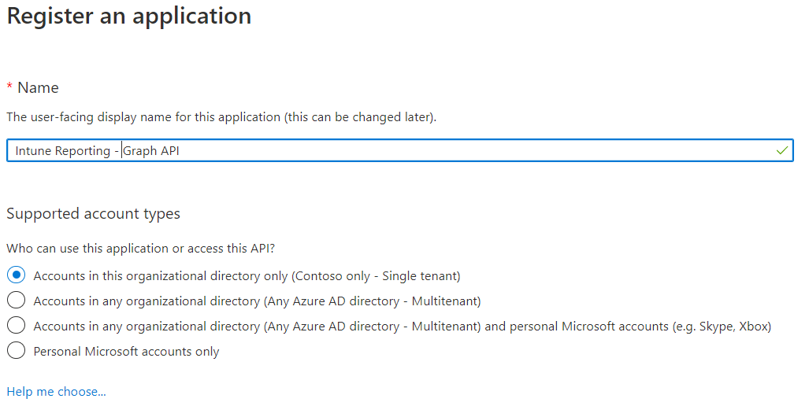
STEP 1a: Create Graph API App Registration
Create an App Registration in Azure AD
Notes:
This slide simply shows the creation of an App Registration.
Once created, we’ll need to grab some information (next slide)

Slide 4
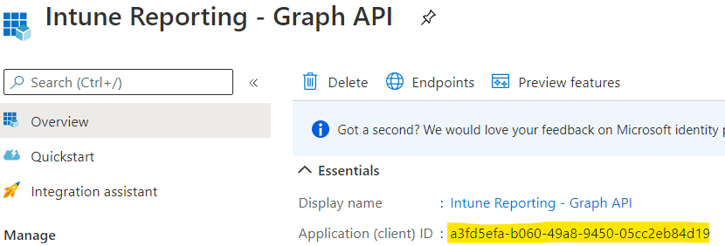
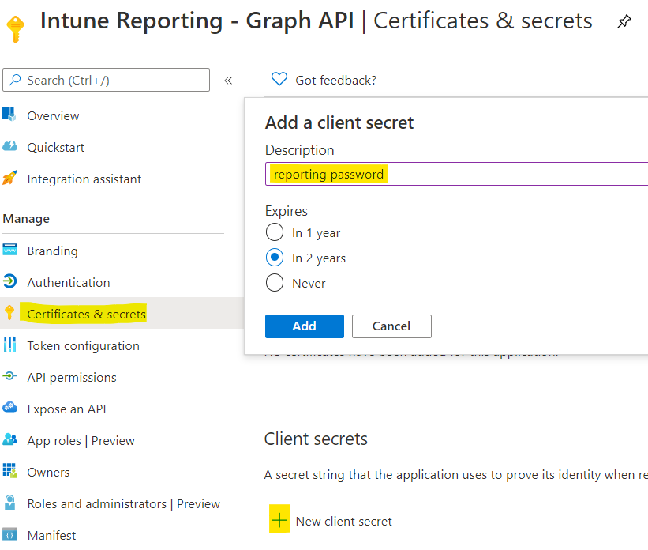
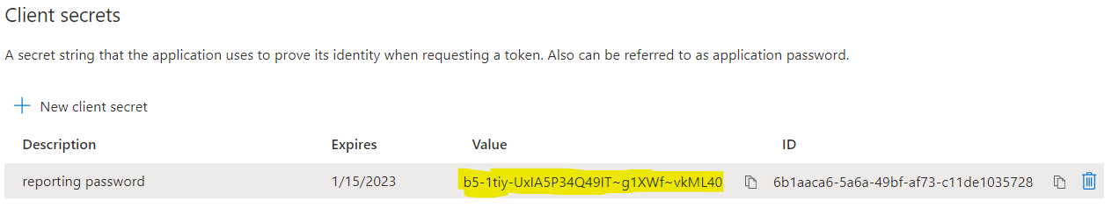
STEP 1b: Create Graph API App Registration
Grab the App ID
Create and grab a secret password
Notes:
First, we’ll grab the Application (client) ID
Next, to keep this service account secure, we create a secret password under “certificates and secrets” and grab the displayed password. Once you leave this page, the password will no longer display in plain text.
The app ID and newly created secret are then used in the PowerShell script/runbook to authenticate to Microsoft Graph
We will see the creation of what’s called a “credential” using these values during the Automation Account setup. This will allow us to hide the password from displaying in plain text as opposed to variables (next slide)

Slide 5
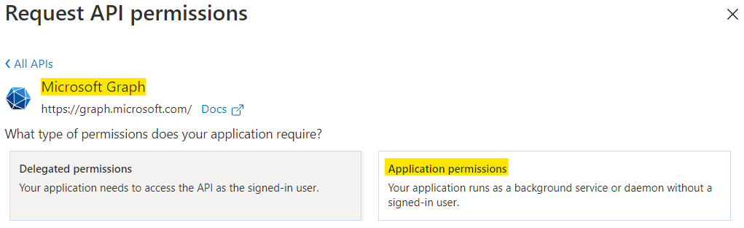
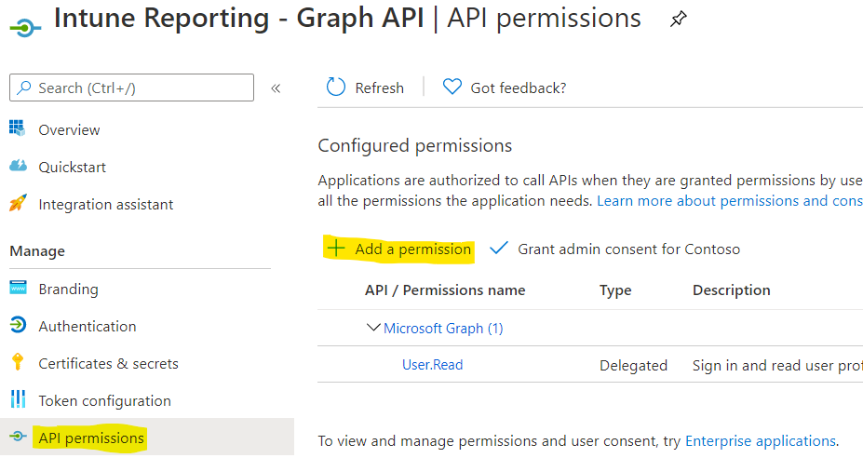
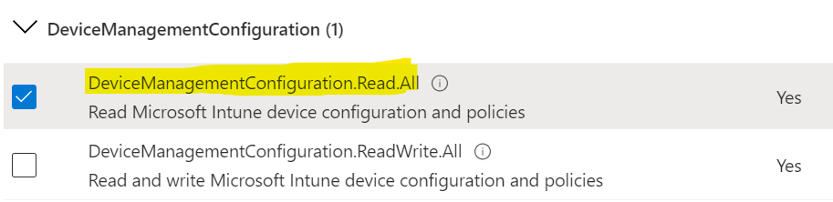
STEP 1c: Create Graph API App Registration
Give the app registration Graph API Application permissions
Notes:
The next step is to grant appropriate API permissions
Remember, permissions are similar to what you would give a service account
These images show the selection of API Permissions in the navigation pane, selecting ‘Add a permission, Navigating to Graph API – Application Permissions, and selecting the appropriate objects
In this example, we’re adding permissions to for the App Registration to access Device Management – Configuration as it relates to our example (next slide)

Slide 6
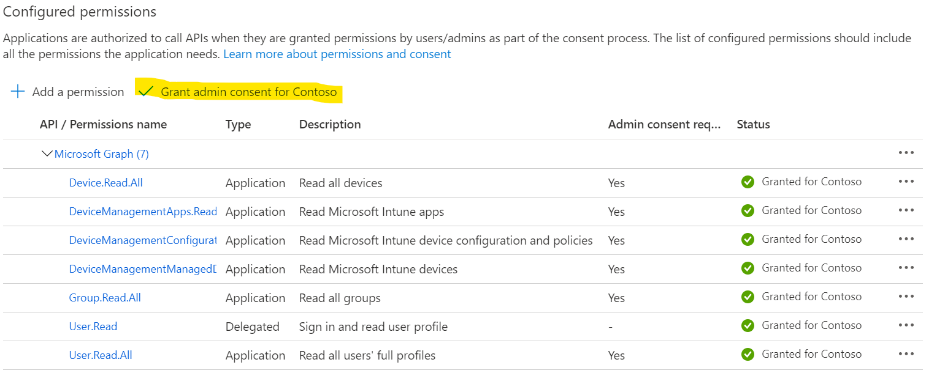
STEP 1d: Create Graph API App Registration
Give the app registration Graph API Application permissions
Antivirus:
DeviceManagementManagedDevices.Read.All
App Install States:
DeviceManagementApps.Read.All
Group.Read.All
Servicing Rings:
DeviceManagement.ManagedDevices.Read.All
DeviceManagement.Configuration.Read.All
Device.Read.All
Group.Read.All
User.Read.All
Device Configuration States:
DeviceManagementConfiguration.Read.All
Device Configuration Groups:
DeviceManagementConfiguration.Read.All
Group.Read.All
Malware:
DeviceManagementManagedDevices.Read.All
Notes:
In our demo, we are leveraging 6 scripts.
Permission for each script is detailed in this slide
The image on the right displays all of these Graph API permissions granted on the app registration within our lab (next slide)

Slide 7
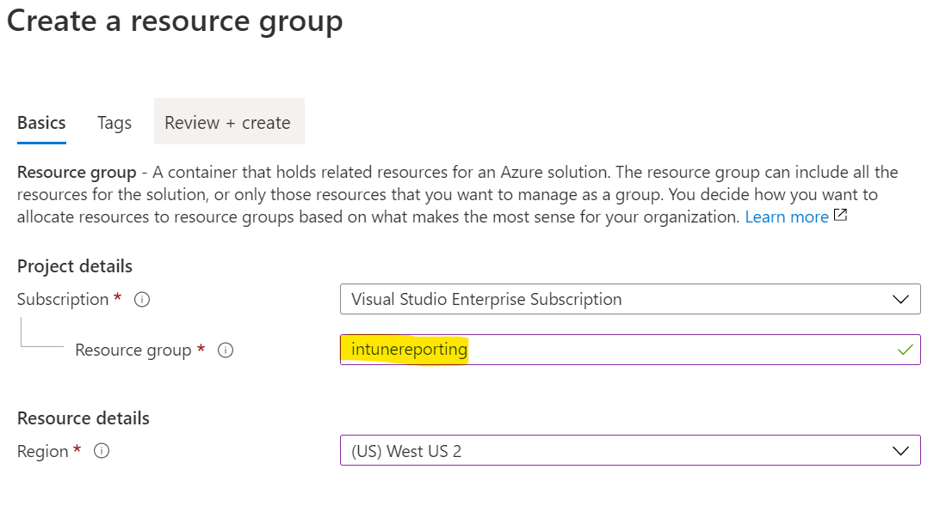
STEP 2: Create Azure Resource Group
*Assumes you have an active Azure Subscription
Create Resource Group within the subscription
Notes:
Step 2 is to create your Resource Group within Azure, which requires an active Azure Subscription
Your Storage Account and Automation Accounts will be created under this resource group (next slide)

Slide 8
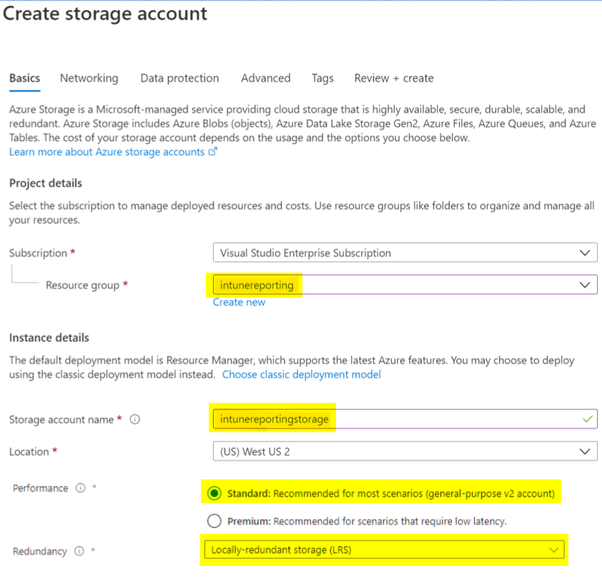
STEP 3a: Set Up Azure Storage Account
Create a Blob Storage account
Notes:
Create your storage account within your resource group
Specify standard blob storage with locally-redundant storage to reduce cost (next slide)

Slide 9
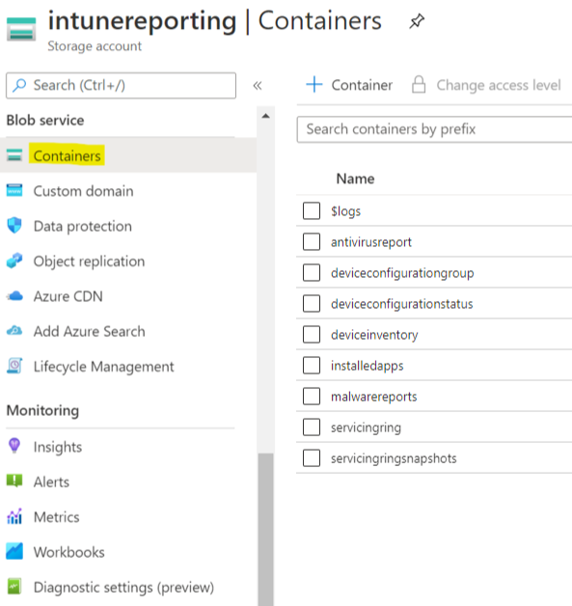
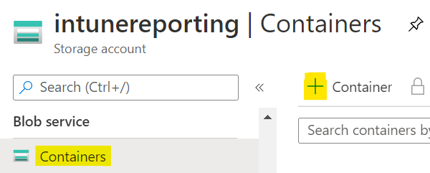
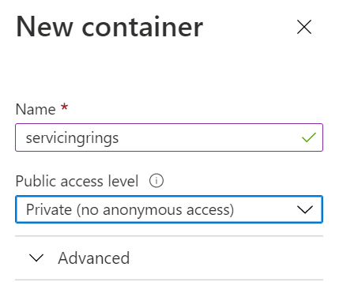
STEP 3b: Set Up Azure Storage Account
Create (or customize) containers as outlined in PowerShell scripts
Runbook:
Notes:
In our example, each runbook we’ve created outputs CSV files into two separate containers.
The first container has a single CSV file containing the latest data set that gets overwritten daily
The second container has multiple CSV files containing historical snapshots of CSV data
Historical data gives enterprises the ability to see progress/changes over time for things like app install status, OS upgrade, etc.
This is an added benefit as Intune does not natively provide that capability at this point.
Please note the name of the containers in the image on the far right as we will point to these using variables in Automation Account setup step (next slide)

Slide 10
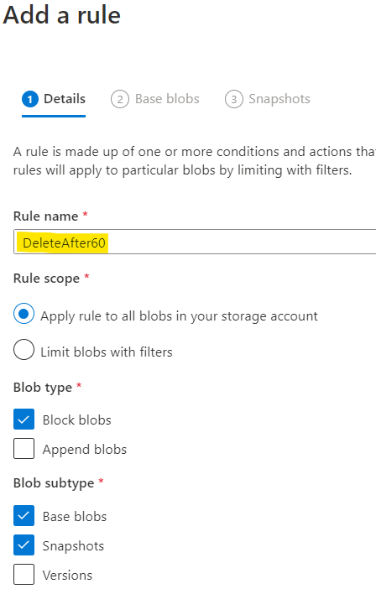
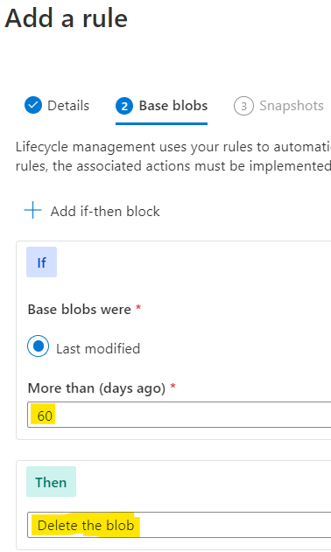
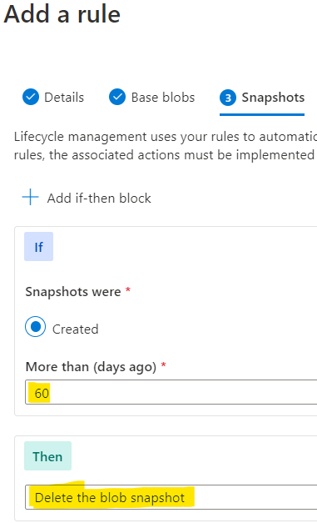
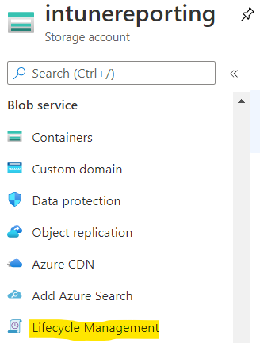
STEP 3c: Set Up Azure Storage Account
Create a lifecycle management policy
Notes:
Before we get there, in order to limit the amount of content in the storage accounts (for cost purposes) we can set lifecycle management policies on the storage account that applies to all blobs
In this example, we created a rule to delete any files/blobs that are older than 60 days. Hence, we are keeping 60 days worth of historical data in our snapshot containers
This can be adjusted based on customer needs for retention (next slide)

Slide 11
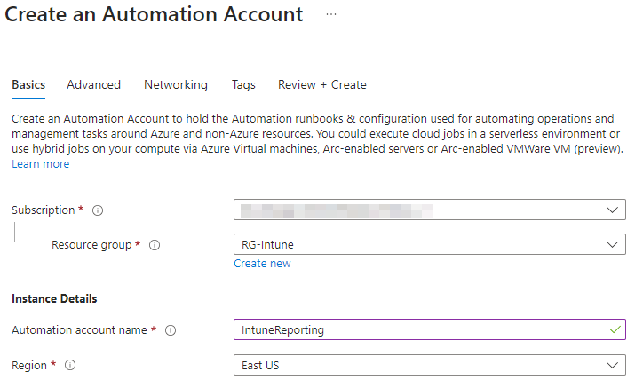
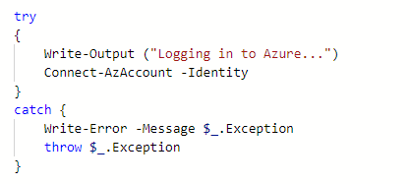
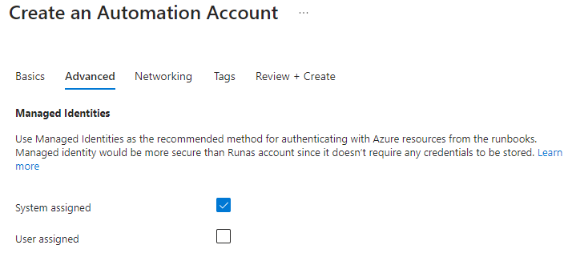
STEP 4a: Set Up Azure Automation Account (Automation)
Create Azure Automation Account
Search for “Automation” in the Azure catalog
Be sure “System assigned” is selected as this is what will be used to connect to your storage account
Runbook:
Notes:
Step 4 is setting up your Automation Account
One thing to note is to ensure the creation of an ‘Azure Run As account’ is set to ‘YES’
This run as account will be used to connect to the storage account within the same subscription in order to upload CSV data.
The code snip shows how we authenticate to the Tenant using the RunAs account within the PowerShell runbook (next slide)

Slide 12
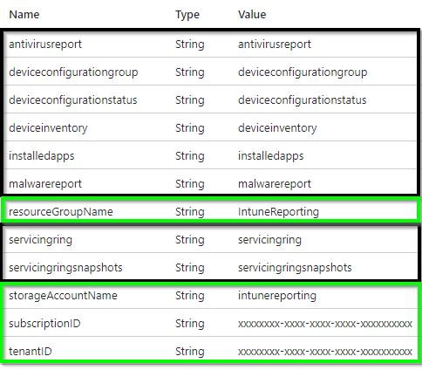
STEP 4b: Set Up Azure Automation Account
Create Automation variables
Green (General Azure variables)
Black (current and snapshot containers created in previous step)
Runbook:
Notes:
The PowerShell runbooks will reference variables created in the Automation Account
All scripts use 4 static variables (subscription ID, tenant ID, resource group name, storage account name) highlighted in green
Variables highlighted in black are unique to the 6 individual scripts
- These variables point to the container names created in the storage account
- Be sure that the values entered for the predefined automation variables point to the appropriate container names in your storage account (case sensitive)
In our lab, the variable name and value (which is the container name) are the same for simplicity purposes (next slide)

Slide 13
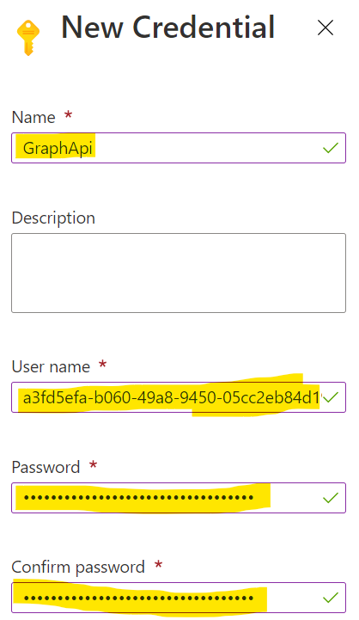
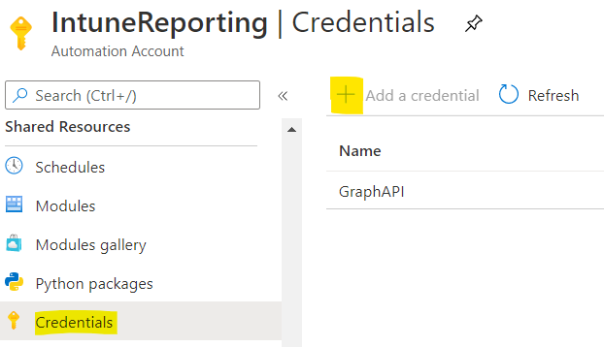
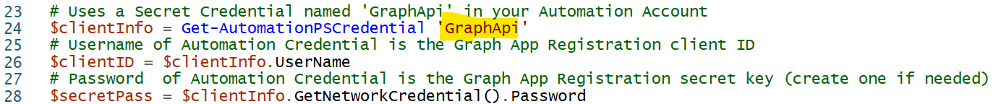
STEP 4c: Set Up Azure Automation Account
Add the ClientId and Client Secret of the App Registration created on Step 1
User name: ClientId
Password: ClientSecret
Runbook:
Notes:
*******Change this screenshot to say GraphApi************
In this step, we’ll be creating a credential within the Automation Account.
Use the client ID and secret password you created in the App Registration. As mentioned, this is your “service account”
This credential will be pulled into the runbook, and used to authenticate to Microsoft Graph
When creating the credential, you may notice that the password is never shown in plan text (next slide)

Slide 14
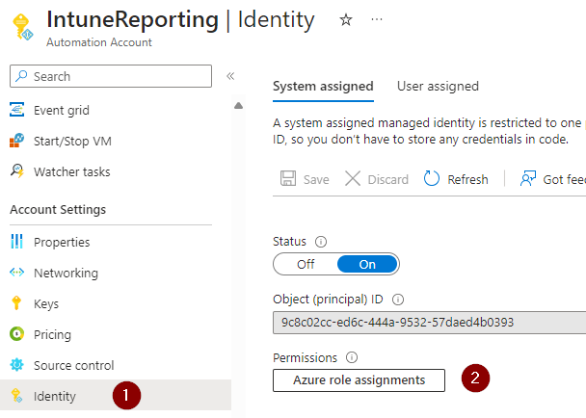
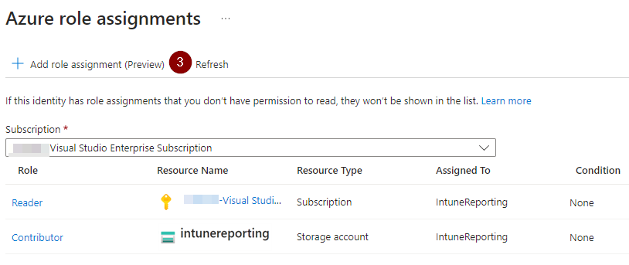
STEP 4d: Set Up Azure Automation Account
Assign permissions to the Subscription and Storage Account
Runbook:
Notes:
*******Change this screenshot to say GraphApi************
In this step, we’ll be creating a credential within the Automation Account.
Use the client ID and secret password you created in the App Registration. As mentioned, this is your “service account”
This credential will be pulled into the runbook, and used to authenticate to Microsoft Graph
When creating the credential, you may notice that the password is never shown in plan text (next slide)

Slide 15
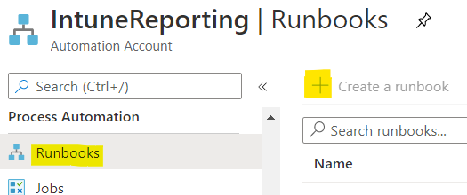
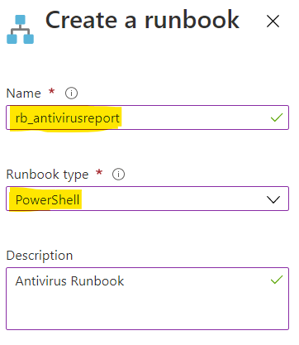
STEP 5a: Set Up Azure Automation Runbooks
Create a Runbook for each automation script
Notes:
Our last step of setting up Azure Resources is to upload our runbooks into our Automation Account
These images display how to create a runbook, add a name and description, and specify the type as PowerShell (next slide)

Slide 16
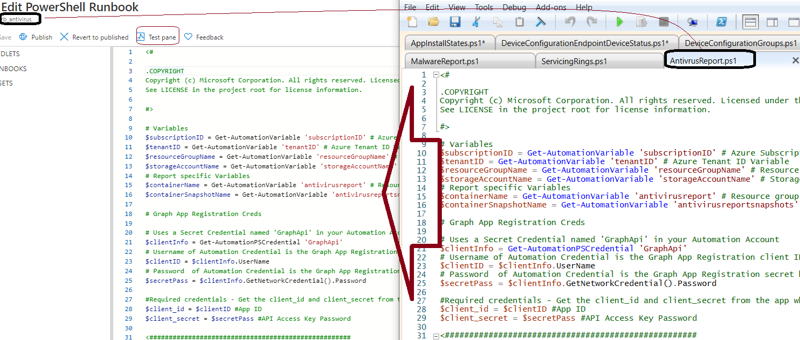
STEP 5b: Setup the Automation Account runbooks
Edit the runbook (Paste the sample scripts into the runbook)
Click Test Pane to test
Notes:
Next we’ll copy all the content from our runbooks into the ‘Edit’ pane
Once pasted, we’ll verify the runbook works as expected by selecting the ‘Test pane’ button at the top (next slide)

Slide 17
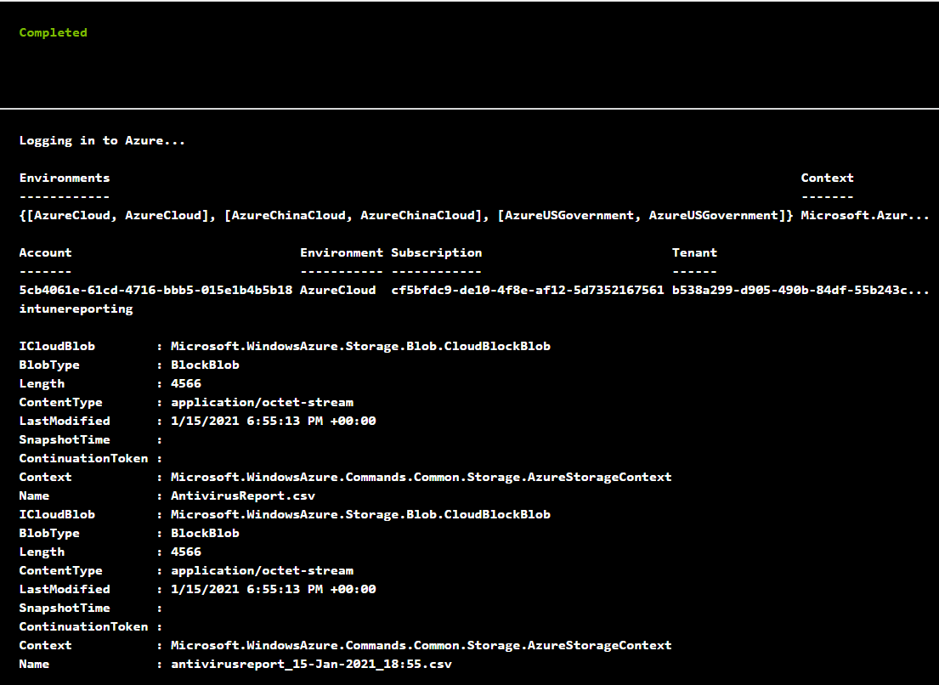
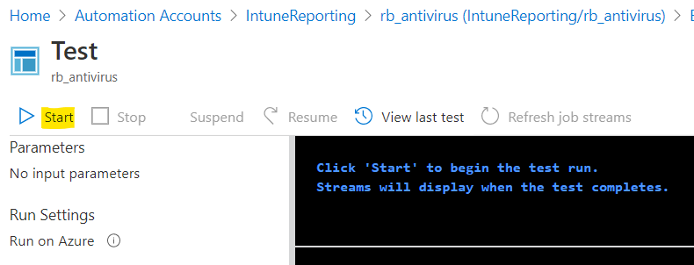
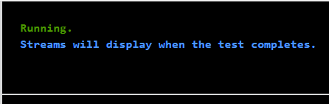
STEP 5c: Setup the Automation Account runbooks
Click ‘Start’
Notes:
Once in the Test Pane view, we’ll click start and see that the runbook is executing
The image on the right shows a completed test and the output. If you are having issues with the script, the test pane is where you can troubleshoot (next slide)

Slide 18
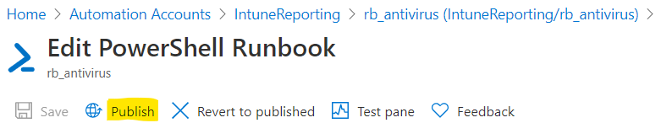
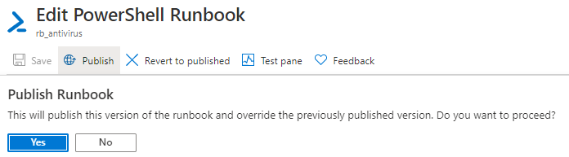
STEP 5d: Setup the Automation Account runbooks
Once tested, click ‘Publish’
Notes:
After testing, select the ‘Publish’ button to finalize the runbook (next slide)

Slide 19

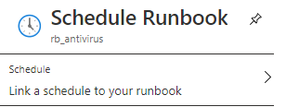
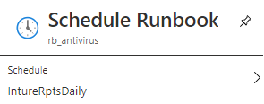
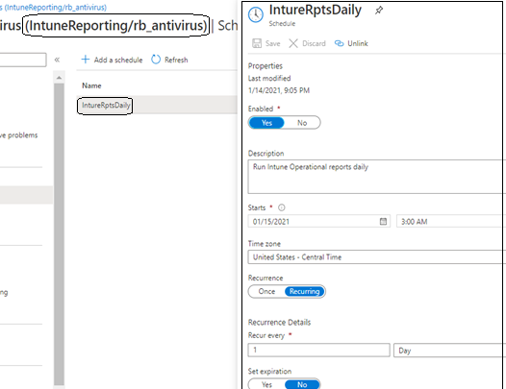
STEP 5e: Schedule the Automation Account runbook
Schedule the runbook
Link to an existing schedule
Verify the schedule
Notes:
Now that we have a working runbook, we want to ensure it runs on a defined schedule
While in the runbook, we can click the ‘link to schedule’ button
In our example, we linked the runbooks to a recurring schedule that started on January 15, 2021 and runs at 3AM once every day (next slide)

Slide 20
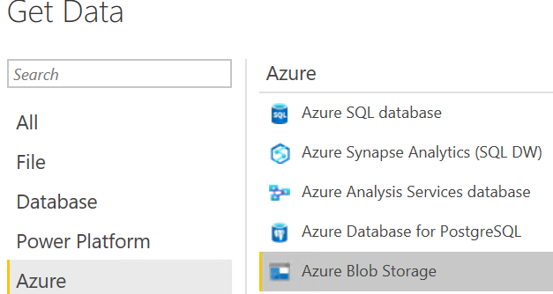
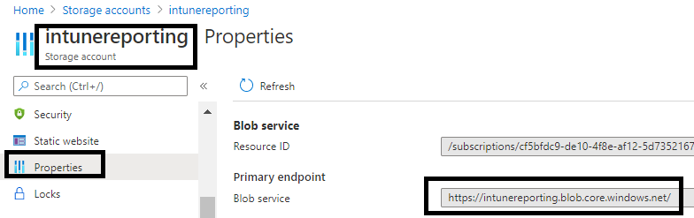
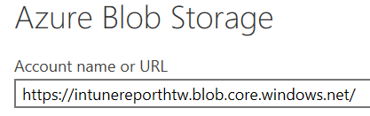
STEP 6a: Launch PowerBI Desktop and Get Data
From PowerBI/Get Data – select Azure Blob
Get the Azure Blob Storage Account Endpoint
Paste it into the Azure Blob Storage URL
Notes:
Now that we’ve gotten CSV data into the storage account, we want to pull that data into Power BI
Select ‘Get Data’ and search for Azure Blob Storage
From your blob storage account, navigate to the ‘Properties’ node and grab the blob service URL
Back in Power BI paste this URL so that we can connect to this storage account (next slide)

Slide 21
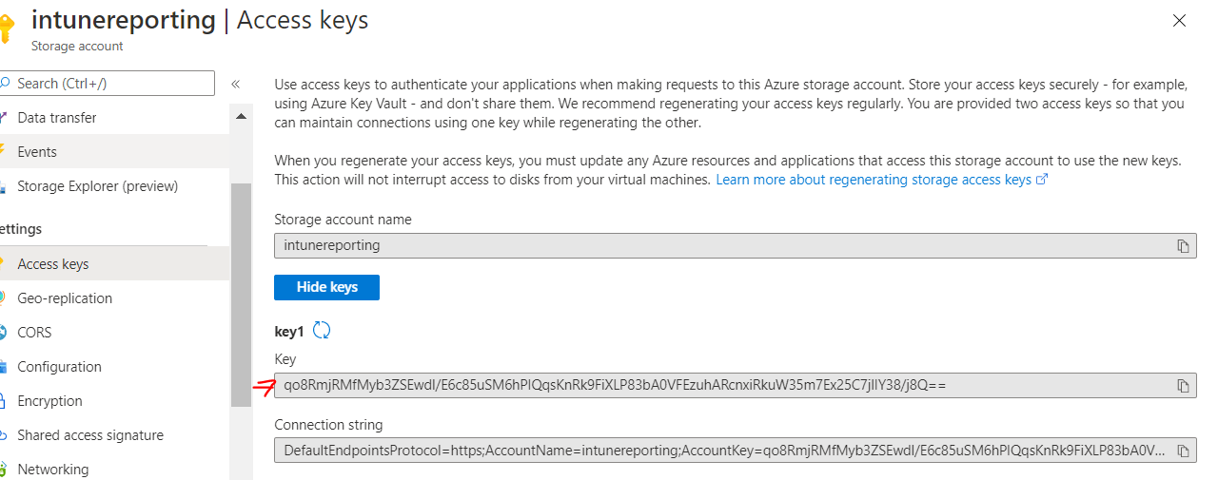
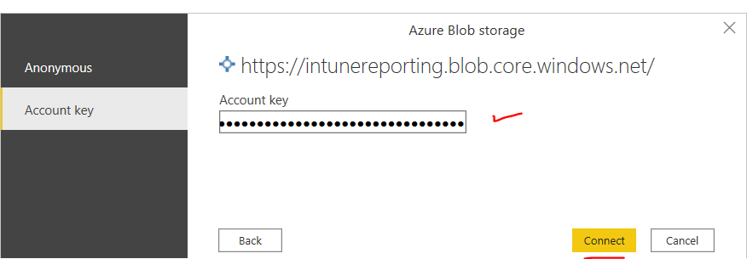
STEP 6b: Launch PowerBI Desktop and Get Data
Get the Access Key
Paste the access key into PowerBI and click “Connect”
Notes:
In order to authenticate, we also need to grab the access key from the storage account
Copy the access key and paste into the ‘Account key’ tab
This will authenticate us into the storage account (next slide)

Slide 22
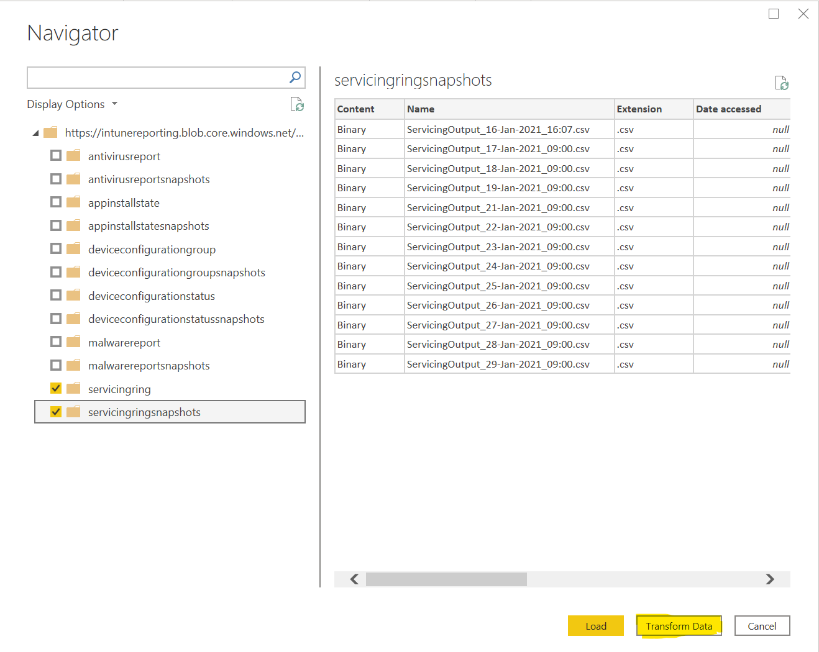
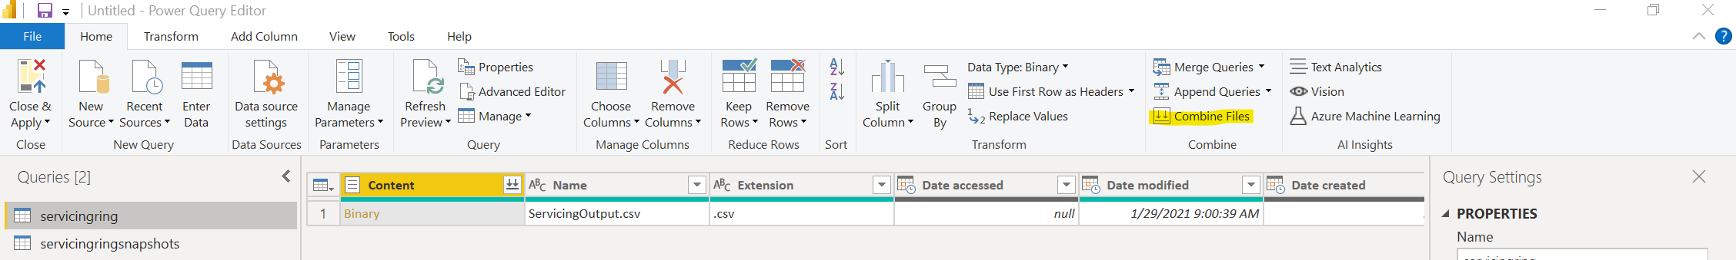
STEP 6c: Transform and Load Data
6. Select the appropriate data you want to import and then choose "Transform Data"
7. Select "Combine Files" to create the data tables
Notes:
You will then see a list of all containers in the storage account.
In this example, we’ve selected just the servicing ring and servicing ring snapshot containers
Transforming the data is necessary in order to create the dashboards (next slide)

Slide 23
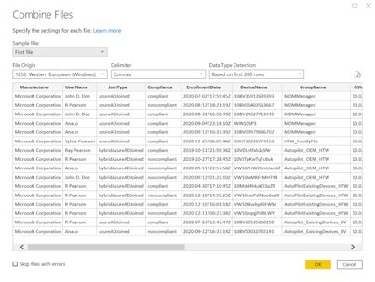
STEP 6d: Close and Apply
8. Select "OK"
9. Close and apply.
Notes:
After transforming the data, we can verify that the data displays as expected
Once verified, select close and apply (next slide)

